Slide 1

IT Essentials (CompTIA A+) Ch. 13
Windows Under the Hood

Slide 2
Overview
In this chapter, you will learn how to:
Work with the Registry
Understand and observe the Windows boot process in detail
Manage processes, services, and threads
Explore Windows tools for programmers

Slide 3
Registry
The Registry is a huge database that stores everything about your PC.
Hardware information
Network information
User preferences
File types
Application information
Windows store the Registry files in:
\%SystemRoot%\System32\config folder

Slide 4
Accessing the Registry
Registry Editor gives direct access to the Registry
Enter regedit at a command prompt
Or in the Start | Search bar

Slide 5
Registry Components
The Registry is organized in a tree structure similar to the folders in the PC.
Once you open the Registry Editor in Windows, you will see five main subgroups, or root keys:
HKEY_CLASSES_ROOT
HKEY_CURRENT_USER
HKEY_USERS
HKEY_LOCAL_MACHINE
HKEY_CURRENT_CONFIG

Slide 6
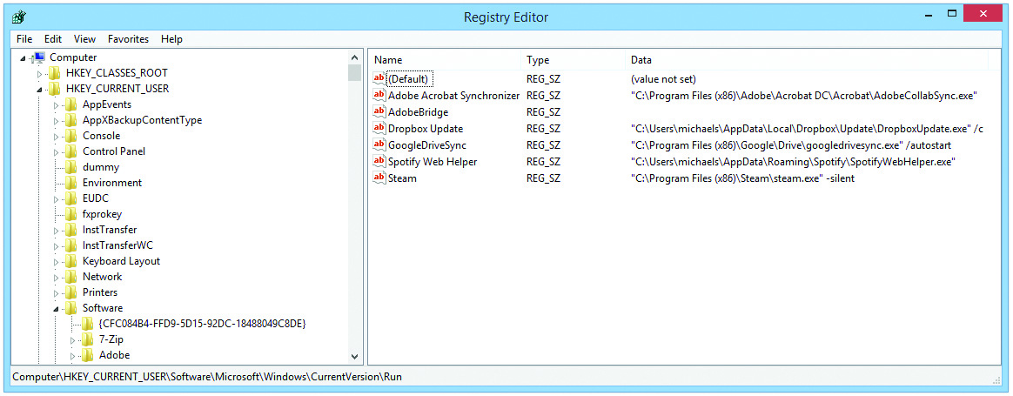
Registry Components
Figure 13.1 Typical Registry root keys, subkeys, and values

Slide 7
Registry Components
HKEY_CLASSES_ROOT
Defines the standard class objects used by Windows (i.e., file types and associations)
HKEY_CURRENT_USER and HKEY_USERS
Stores all of the personalized information for all users on a PC
HKEY_LOCAL_MACHINE
System’s non-user-specific configurations
HKEY_CURRENT_CONFIG
Options currently being used

Slide 8
Talkin’ Registry
Values must have a defined type of data they store:
String value: any form of data
Binary value: long strings of ones and zeros
DWORD value: Binary values limited to exactly 32 bits
QWORD value: Binary values limited to exactly 64 bits
There are other types of values, but these four are used for most Registry entries.

Slide 9
Manual Registry Edits
Manually editing the Registry may break things in Windows.
Applications might not start; utilities might not work; the computer might not boot.
Always back up the Registry before you change anything.
Create a secure backup on different media (e.g., USB thumb drive).
After editing, reboot system to see if the changes you made had the desired result.

Slide 10
Manual Registry Edits
Registry Editor’s Export feature enables you to:
Save the full Registry
Or save a single root key or subkey (including all subkeys and values under it)

Slide 11
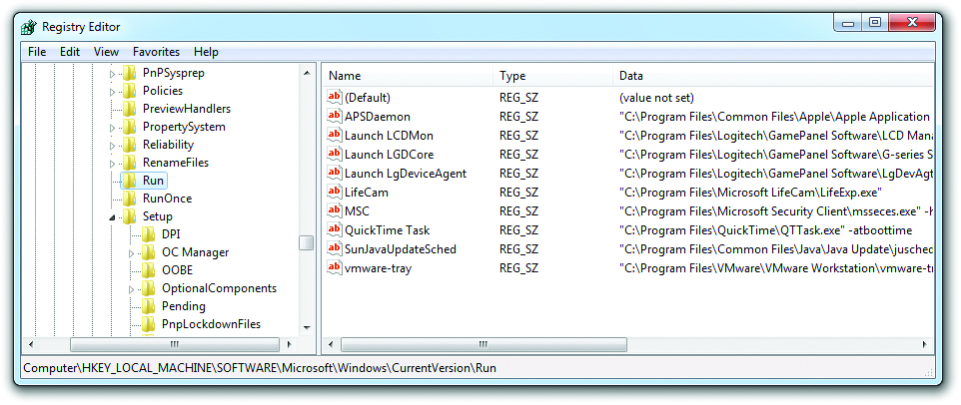
Manual Registry Edits
Figure 13.3 Mike’s Run subkey

Slide 12
CLI Registry Editing Tools
reg command
Full Registry editing tool
View Registry keys and values
Import and export some or all of a Registry
Compare two different versions of a Registry
Tailor a command to accomplish very tight Registry edits
regsvr32 command
Modifies the Registry in only one way—adding (or registering) dynamic link library (DLL) files as command components
Notes:
“Working with the Command-Line Interface” in Chapter 16 may be helpful to read at this point for those who are not familiar with the command-line interface.

Slide 13
The Boot Process
Current Windows versions support both BIOS and UEFI boot processes.
BIOS-based system
The BIOS uses its boot order to scan a hard drive for a master boot record (MBR).
MBR loads its boot sector, which contains code pointing to the bootmgr file.
The bootmgr loads winload.exe, which readies your system to load the operating system kernel.
UEFI system
Bootmgr loads directly.

Slide 14
The Boot Process
Bootmgr starts and reads data from a Boot Configuration Data (BCD) file.
BCD contains information about the various operating systems installed on the system as well as instructions for how to actually load (bootstrap) them.
Once an operating system is selected (immediately, if only one is present), bootmgr loads winload.exe.
Readies your system to load the operating system kernel.
Notes:
Note: The BCD file replaces the boot.ini file used in previous operating systems and can be altered by using the command-line tool bcdedit.exe

Slide 15
The Boot Process
Winload.exe loads:
Hardware abstraction layer
The system Registry
Drivers for any boot devices into memory before the operating system itself takes over
Once the operating system process (ntoskrnl.exe) takes over, it loads all of the various processes and systems that comprise Windows, and the Windows logo comes up.
Notes:
Note: Unlike Windows XP, the boot files and the system files must all reside on the same partition in Vista/7.

Slide 16
Processes and Services
In Windows, programs are executable files waiting on a mass storage device.
When a program is started, Windows loads it into RAM as a process.
The CPU reads the process; the process tells the CPU which bits of code to run.
Windows is a multitasking operating system—it can run many processes simultaneously.

Slide 17
Processes and Services
Some processes are called applications; some are called services.
Applications run on screen or in the foreground.
Services run in the background and perform support tasks.

Slide 18
Task Manager
Windows Task Manager is the one-stop-shop for anything you need to do with applications, processes, and services.
To open Task Manager in Windows Vista/7:
Press ctrl-shift-esc
Start | Search and type taskmgr and press enter
Press ctrl-alt-delete and select Task Manager

Slide 19
Task Manager in Windows
The Applications tab shows all the running applications on your system.
Use if an application will not close normally to force it to shut down.
Switch To enables you to bring any program to the front.
New Task enables you to start any program you wish, as long as you know the executable.

Slide 20
Task Manager in Windows
The Processes tab shows you every running process on your computer.
A process is named after its executable file.
Usually ends in .exe but can also end with other extensions.
All processes have a user name to identify who started the process.
A process started by Windows has the user name System.

Slide 21
Task Manager in Windows
All processes have a process identifier (PID).
To identify a process, you use the PID, not the process name.
Task Manager doesn’t show the PID by default.
Mark the checkbox under View>Select Columns to display the PID.
Notes:
Demonstrate for students!!!!!!!!!!!!!!!!!!!!!!!!!!!!!!!!!

Slide 22
Task Manager in Windows
The Processes tab shows the amount of CPU time (percentage) and the amount of RAM (kilobytes) the process is using.
By default, the Task Manager shows only processes associated with the current user.
Click on Show processes from all users to see every process on the system.
If you select a process and click the End Process button, you’ll instantly end that process.
If the process is an application, that application will close.

Slide 23
Task Manager in Windows
Right-click on a process to display a number of options:
Open File Location, Debug, UAC Virtualization, Dump files, Set priority, Set Affinity, and other choices
The Properties option offers options similar to Windows Explorer.
Go to Service(s) will move you to the Services tab of the Task Manager, showing you all services associated with the process.

Slide 24
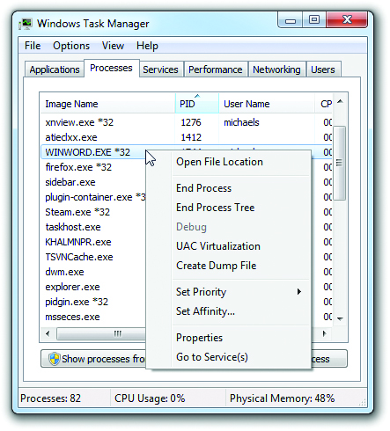
Task Manager in Windows
Figure 13.10 Processes detail on right-click

Slide 25
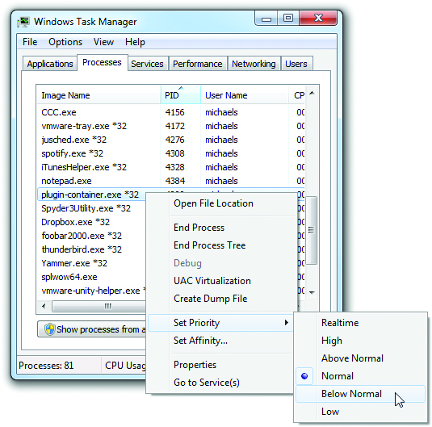
Task Manager in Windows
Figure 13.11 Process priority

Slide 26
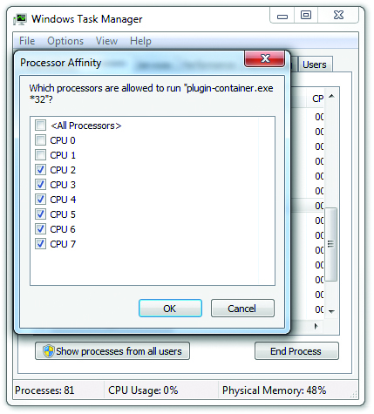
Task Manager in Windows
Figure 13.12 Turning off affinity to the first two cores

Slide 27
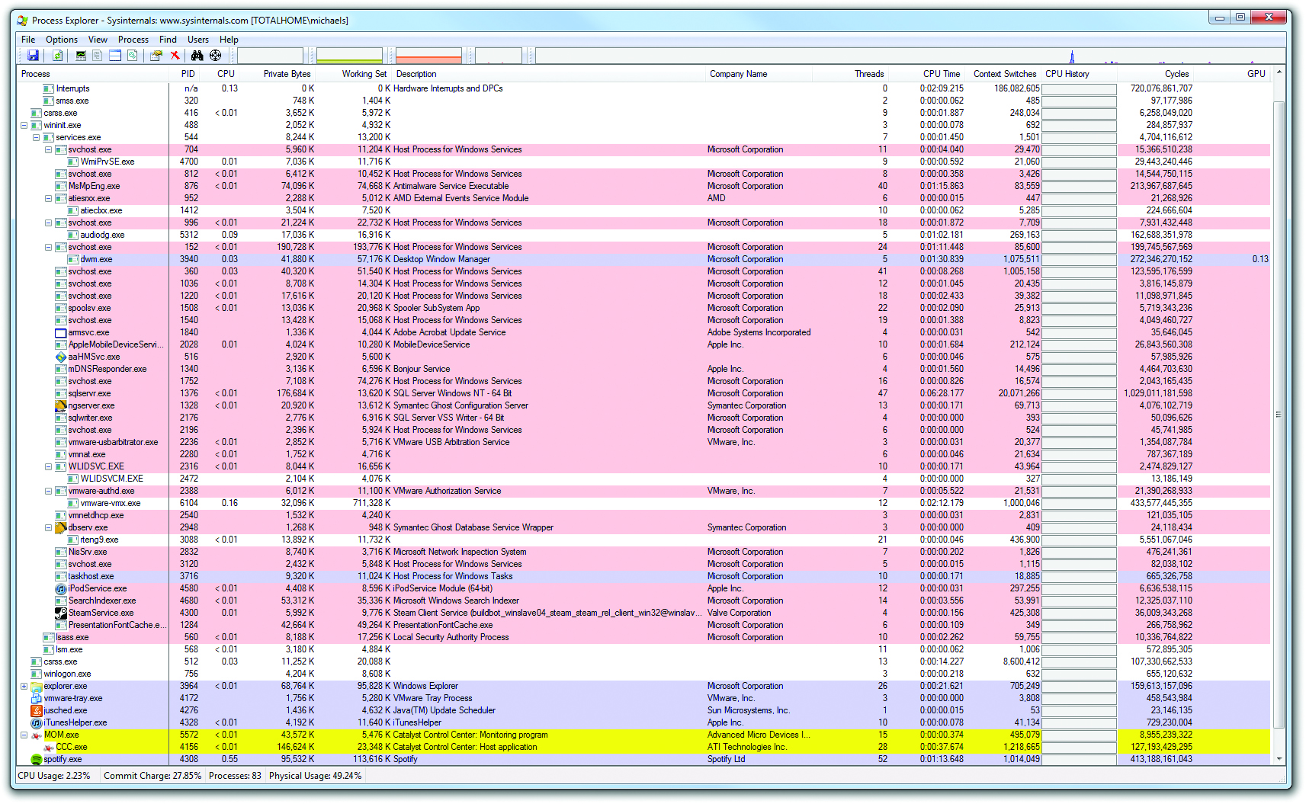
Task Manager in Windows
Figure 13.14 Process Explorer

Slide 28
Task Manager in Windows
Use the Services tab in the Task Manager to work with services directly—they can be stopped or started, and you can go to the associated process.
The best way to work with services is to use the Services Control Panel applet.
Services don’t have their own window, so you use the Services applet to start, stop, and configure them.
You can see if a service is running by reading the Status column.

Slide 29
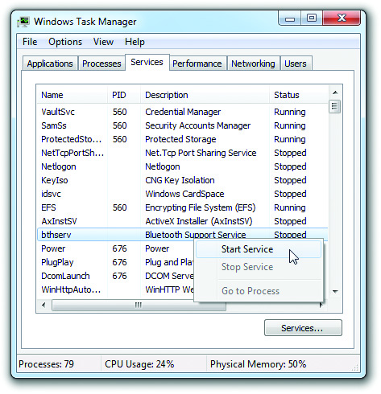
Task Manager in Windows
Figure 13.15 Services tab in Task Manager

Slide 30
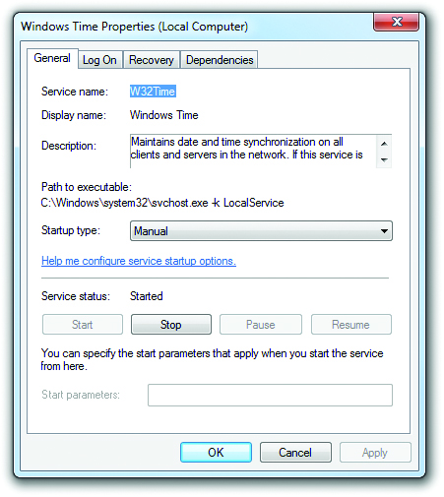
Task Manager in Windows
Figure 13.17 Service Properties dialog box

Slide 31
Task Manager in Windows
Performance
Task Manager allows one to assess how hard RAM and the CPU are working at any given moment and why.
Click the Performance tab to reveal a handy screen with the most commonly used information:
CPU usage, available physical memory, size of the disk cache, commit charge (memory for programs), and kernel memory (memory used by Windows).
Task Manager also tells you what program is using CPU and RAM resources.

Slide 32
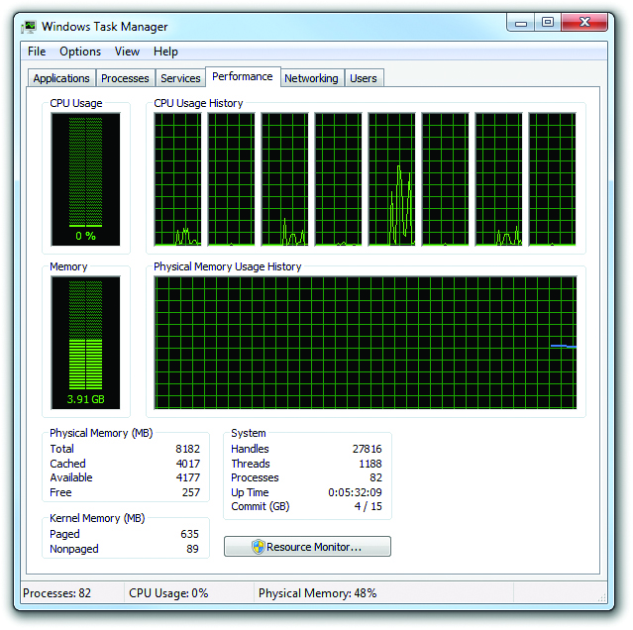
Task Manager in Windows
Figure 13.18 Task Manager Performance tab

Slide 33
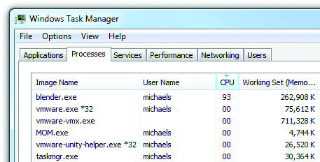
Task Manager in Windows
Figure 13.19 CPU usage

Slide 34
Task Manager in Windows
Networking and users
Remaining tabs in Task Manager enable you to see:
Network use at a glance shows network traffic activity and can help troubleshoot network performance problems.
Which users’ accounts are currently logged on to the local machine and enables you to log off other users if you have the proper permissions.

Slide 35
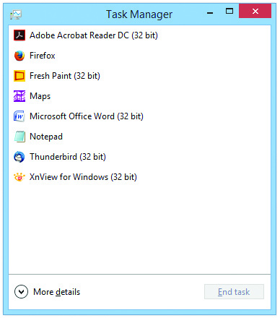
Task Manager in Windows 8
Significantly updated in Windows 8
New Fewer Details view with a simple interface for seeing and terminating running programs.
Figure 13.20 Fewer details view in Windows 8 Task Manager

Slide 36
Task Manager in Windows
Processes
In detailed mode, Processes is broken into three sections: Apps, Background processes, and Windows processes.
By default, the Processes tab lists a process description, its status, and its resource use, including CPU, Memory, Disk I/O, and Network I/O.
Most advanced options have moved to the context menu of the Details tab.

Slide 37
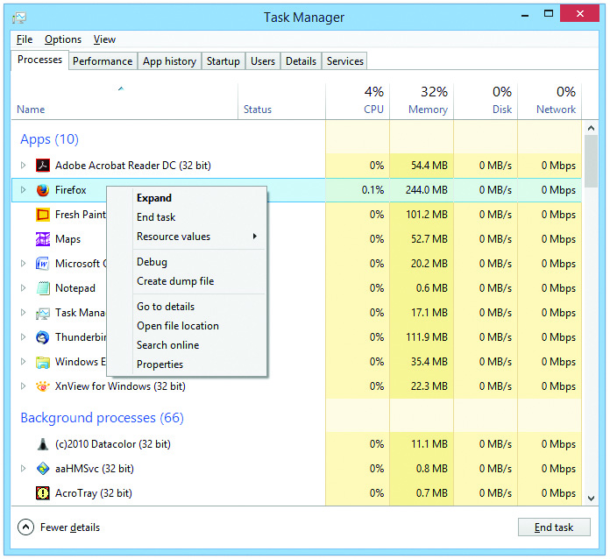
Task Manager in Windows
Figure 13.22 Processes tab context menu in Windows 8 Task Manager

Slide 38
Task Manager in Windows
Performance
Networking and Disk I/O have been added to the Performance tab.
This provides one simple place to view all major performance metrics.
App history
The App history tab collects recent statistics on CPU time and network usage.
These statistics help identify resource-hungry programs.

Slide 39
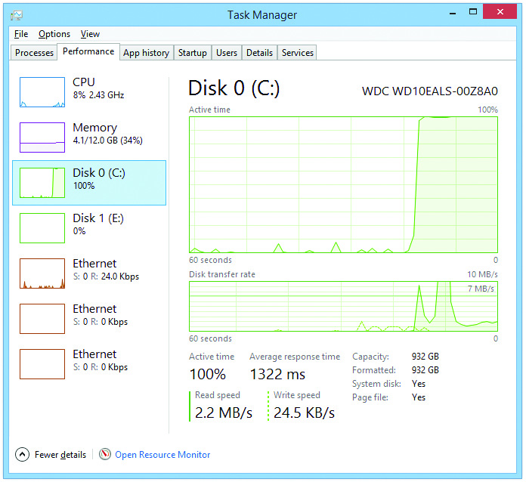
Task Manager in Windows
Figure 13.23 Performance tab in Windows 8 Task Manager showing a very active Disk 0

Slide 40
Task Manager in Windows
Startup
The Startup tab enables you to identify and disable rogue startup programs.
Users
The Users tab shows programs running under a user’s account and clearly indicates resource use.
Details
The Details tab inherits most of the functionality removed from the old Processes tab.
Services
The Services tab is virtually unchanged.

Slide 41
Task Manager in Windows
The tasklist and taskkill commands
These commands enable you to work with tasks from the command-line.
The tasklist command enables you to view running processes on a local or remote system.
You can kill a process using the taskkill command, using either the name or the PID.

Slide 42
Performance Tools
Reliability and Performance Monitor (Windows Vista) and Performance Monitor (Windows 7)
These tools track metrics regarding resource usage.
Objects and counters
An object is a system component that is given a set of characteristics and can be managed by the OS as a single entity.
A counter tracks specific information about an object.

Slide 43
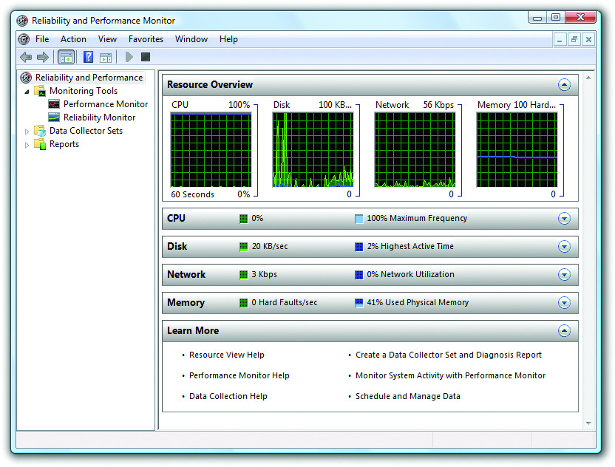
Performance Tools
Figure 13.29 Resource Overview in Windows Vista

Slide 44
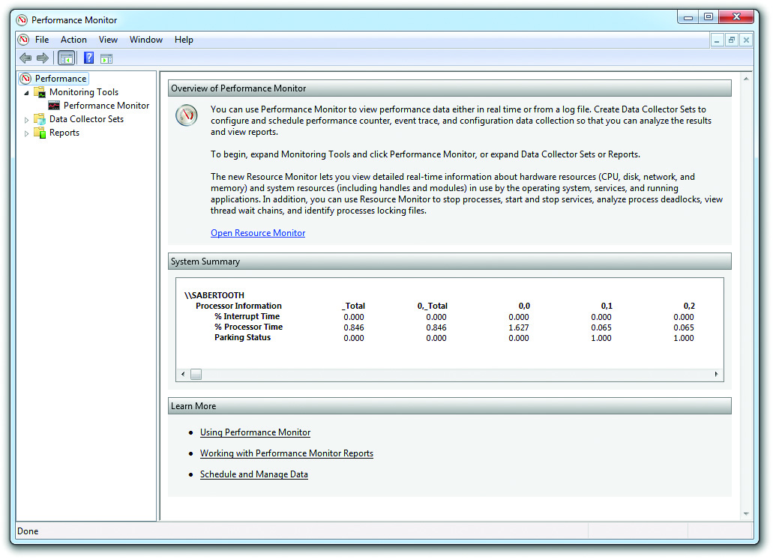
Performance Tools
Figure 13.31 Initial Performance Monitor screen in Windows 7

Slide 45
Performance Tools
Working with the tools
Performance monitor gathers and displays real-time data on objects such as memory, physical disk, processor, and network.
To add counters, open the Add Counters dialog box.
Selecting a counter and pressing ctrl-h makes that counter data stand out on the graph.
Notes:
The Windows Experience Index runs on a scale from 1.0 to 7.9 and gives you a pretty good gauge of the relative strengths and weaknesses of a system.

Slide 46
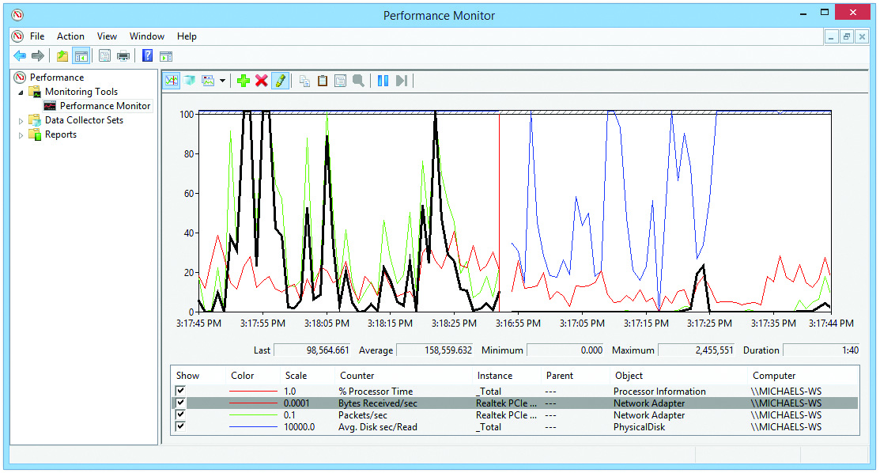
Performance Tools
Figure 13.34 Pressing ctrl-h makes one set of data stand out.

Slide 47
Performance Tools
Data Collector Sets are groupings of counters you can use to make reports.
You can make your own Data Collector Sets (User Defined) or use one of the predefined system sets.
Data Collector Sets enable you not only to choose counter objects to track but also to schedule when you want them to run.

Slide 48
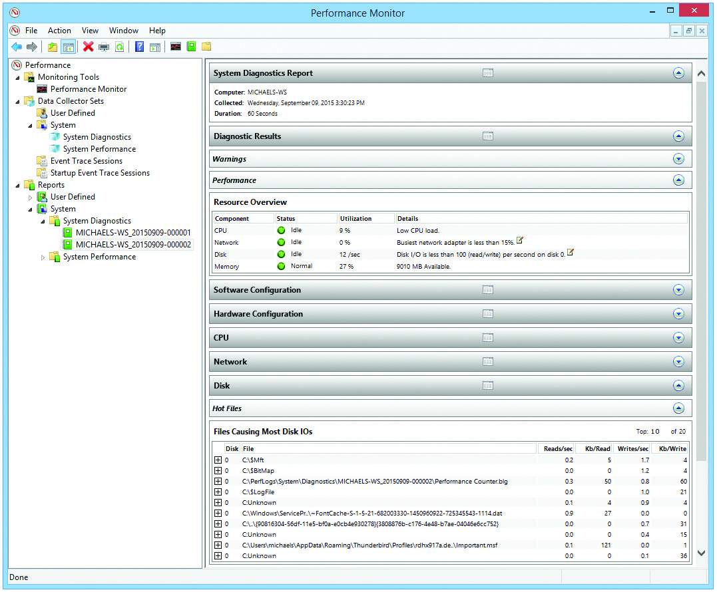
Performance Tools
Figure 13.35 Sample report

Slide 49
Component Services
Component services are tools to enable programmers to share data objects (an element of programs) between applications on a single computer.
Over time, this sharing was extended so that you could share objects between computers on a network.
In almost all cases, sharing objects doesn’t require you to do anything more than install an application that uses these features.

Slide 50
Component Services
Component Services is there for those very rare times when something’s either wrong or a programmer needs you to make manual changes.

Slide 51
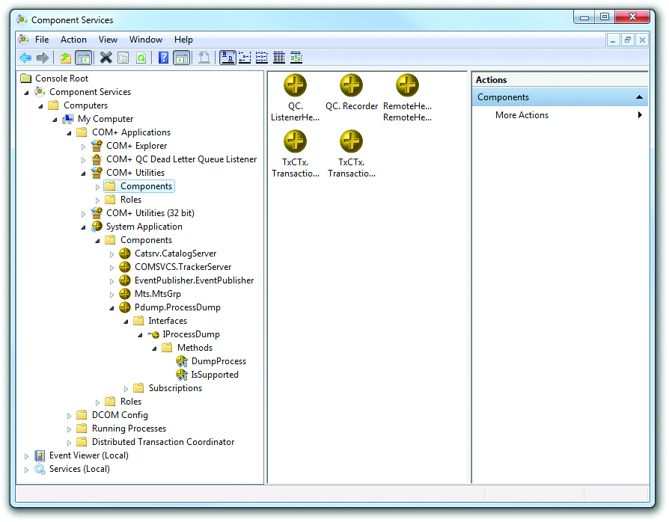
Component Services
Figure 13.36 Component Services in Windows 7

Slide 52
Data Sources
Open Database Connectivity (ODBC)
Coding standard that enables programmers to write databases and the applications that use them
Can query ODBC to see how to locate and access a database without any concern about what application or operating system is used

Slide 53
Data Sources
Microsoft’s tool to configure ODBC is called ODBC Data Source Administrator.
Data Source Administrator enables you to create and manage entries called Data Source Names (DSNs) that point OBDC to a database.
DSNs are used by ODBC-aware applications to query ODBC to find their databases.
You will rarely use Data Source Administrator unless you’re making your own shared databases.

Slide 54
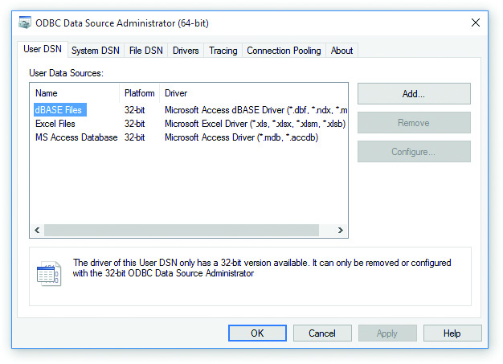
Data Sources
Figure 13.37 ODBC Data Source Administrator in Windows 8.1

Slide 55
Questions?

Slide 56
Summary
Work with the Registry
Understand and observe the Windows boot process in detail
Manage processes, services, and threads
Explore Windows tools for programmers

Slide 57


